Slide 1





GLA UNIVERSITY
Computer Network

Slide 2

Digital-to-Digital Conversion

Slide 3
Digital-to-digital conversion
In this section, we see how we can represent digital data by using
digital signals
The conversion involves three techniques:
  line coding
  block coding
  scrambling
Line coding is always needed block coding and scrambling may or
may not be needed

Slide 4
Line Coding
Converting a string of 1’s and 0’s (digital data) into a sequence of
signals that denote the 1’s and 0’s
Eg:
  a high voltage level (+V) could represent a “1” AND
  a low voltage level (0 or -V) could represent a “0”

Slide 5
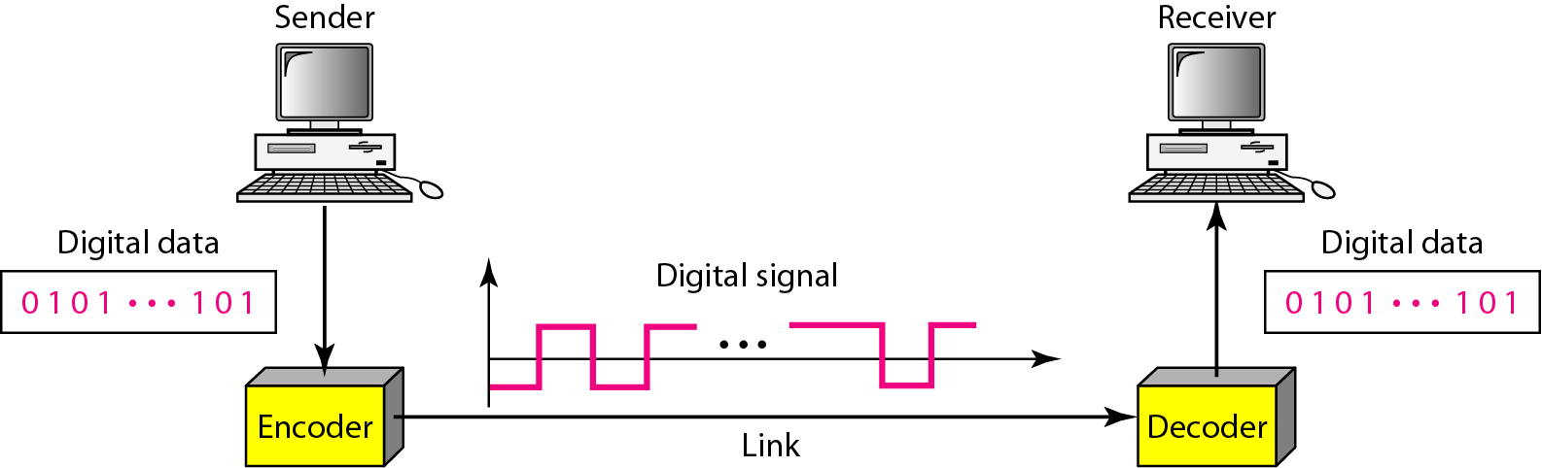
Line coding and decoding

Slide 6
Mapping Data symbols onto Signal levels
A data symbol can consist of a number of data bits
– 1, 0 OR
– 11, 10, 01, etc
A data symbol can be coded into a single signal element or
multiple signal elements
– 1 → +V, 0 → -V
The ratio ‘r’ is the number of data elements carried by a signal
element

Slide 7
Relationship b/w data rate and signal rate
Data rate
  the number of bits sent per sec (bps)
  it is often referred to the bit rate
Signal rate
  the number of signal elements sent in a second
  it is measured in bauds
  it is also referred to as the modulation rate or baud rate

Slide 8
Relationship b/w data rate and signal rate
Data Signal
A data element is the smallest entity that can represent a piece of information (bit)
Data elements are what we need
to send
Data elements are being carried
Data rate defines the number of
data elements (bits) send in 1s
Unit is bps
A signal element is the shortest
unit of the digital signal
Signal element are what we can
send
Signal elements are the carriers
Signal rate is the number of signal elements send in 1s
Unit is baud

Slide 9
Data element vs data element

Slide 10
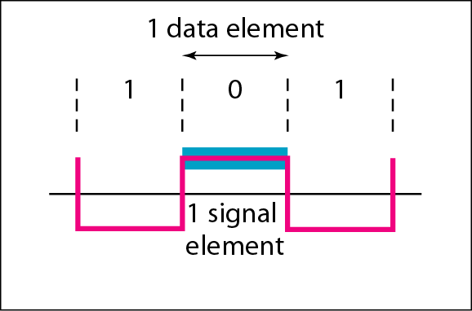
Data element vs Signal element

Slide 11
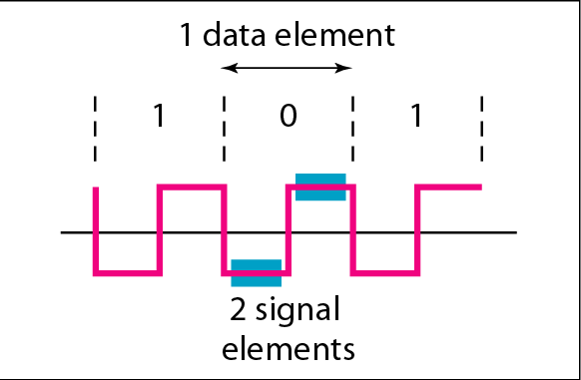
Data element vs Signal element

Slide 12
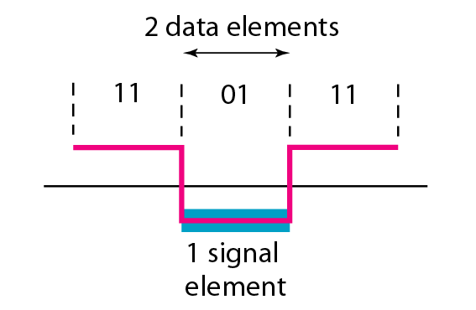
Data element vs Signal element

Slide 13
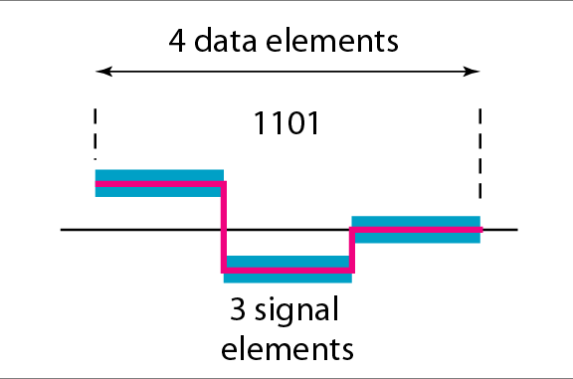
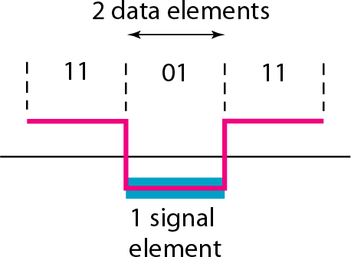
Data element vs Signal element

Slide 14
Baud rate
The baud or signal rate can be expressed as:
S = c x N x 1/r bauds
where,
c is the case factor (worst, best & avg.)
N is data rate
r is the ratio between data element & signal element

Slide 15
Baud rate
Eg:
– A signal is carrying data in which one data element is encoded as one signal element (r = 1). If the bit rate is 100 kbps, what is the average value of the baud rate if c is between 0 and 1?
Solution
We assume that the average value of c is 1/2 . The baud rate is
then
S = c * N * 1/r
= ½ * 100000 * 1
= 50000
= 50k baud

Slide 16

Baud rate
Eg:
– Calculate the value of signal rate for each of the cases if data rate is 1 Mbps and c= 1/2

Slide 17
Line Coding
Data as well as signals can either be digital or analog
Line coding is the process of converting digital data to digital signals
By this technique we converts a sequence of bits to a digital signal
At the sender side digital data are encoded into a digital signal and at the receiver side the digital data are recreated by decoding the digital signal

Slide 18
Line Coding
We can divide line coding schemes into five categories
  Unipolar (Eg: NRZ scheme)
  Polar (Eg: NRZ-L, NRZ-I, RZ, and Biphase – Manchester and differential Manchester)
  Bipolar (Eg: AMI and Pseudoternary).
  Multilevel
  Multi-transition

Slide 19
Characteristics of Line Coding techniques
There should be self-synchronizing i.e., both receiver and sender
clock should be synchronized
There should have some error-detecting capability
There should be immunity to noise and interference
There should be less complexity
There should be no low frequency component, as long distance transfer is not feasible for low frequency component signal
There should be less base line wandering

Slide 20
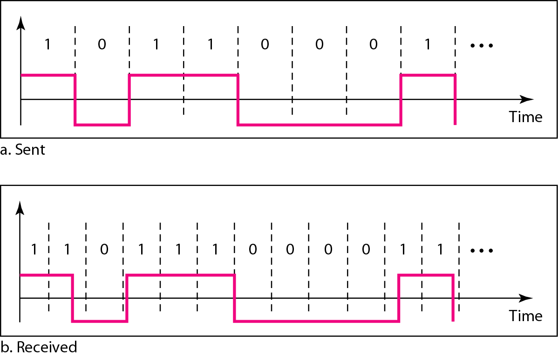
Characteristics of Line Coding techniques

Slide 21
Eg:
– In a digital transmission, the receiver clock is 0.1 percent faster than the sender clock. How many extra bits per second does the receiver receive if the data rate is 1 kbps? How many if the data rate is 1 Mbps?
Solution
At 1 kbps, the receiver receives 1001 bps instead of 1000 bps
At 1 Mbps, the receiver receives 1,001,000 bps instead of
1,000,000 bps

Slide 22
Unipolar Line Coding Scheme
All signal levels are on one side of the time axis
  either above or below
  Eg: NRZ (Non Return to Zero)
The signal level does not return to zero during a symbol transmission
The signal will change level at the edge of the time interval and not in between
Disadvantages
  Scheme is subject to baseline wandering
  It has no synchronization or any error detection
  It is simple but costly in power consumption

Slide 23
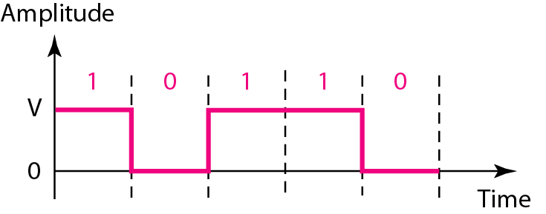
Unipolar - NRZ scheme
Assumption: data element ‘1’ is on positive side of axis and data
element ‘0’ is on the axis
NOTE: data element ‘1’ is on negative side of axis and data element ‘0’ is on the axis can also be assumed

Slide 24
Polar – NRZ Line Coding Scheme
The voltages are on both sides of the time axis
The signal level does not return to zero during a symbol transmission
The signal will change level at the edge of the time interval and not in between
Polar NRZ scheme can be implemented with two voltages
  E.g. +V for 1 and -V for 0 or vice versa
There are two versions:
  NRZ - Level (NRZ-L) - positive voltage for one symbol and negative for the other
  NRZ - Inversion (NRZ-I) - the change or lack of change in polarity determines the value of a symbol
    E.g. a 1 symbol inverts the polarity a 0 does not

Slide 25
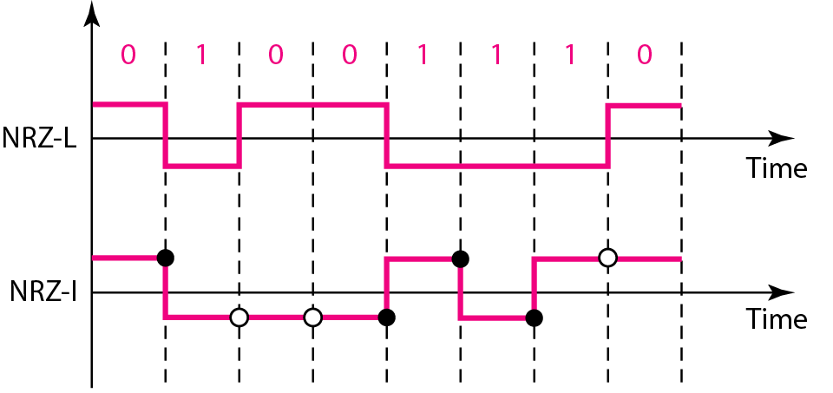
Polar NRZ-L and NRZ-I schemes

Slide 26
Polar NRZ-L and NRZ-I schemes
In NRZ-L the level of the voltage determines the value of the bit
In NRZ-I the inversion or the lack of inversion determines the value of the bit

Slide 27
Polar – RZ Scheme
The Return to Zero (RZ) scheme uses three voltage values
– +, 0, -
Each symbol has a transition in the middle
– Either from high to zero or from low to zero
The signal will change level in between of the signal element or bit duration
The signal will not change level at the edge of the time interval
This scheme has more signal transitions (two per symbol) and therefore requires a wider bandwidth

Slide 28
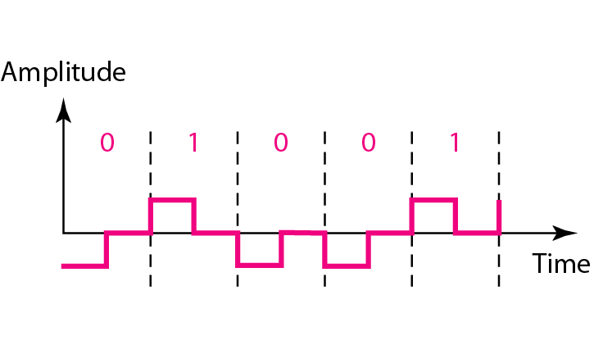
Polar RZ scheme
One bit duration, signal is returning to zero axis during the bit i.e., at the middle of the signal element transmission and not at the edge of the interval

Slide 29
Polar Biphase
Manchester coding
  combining the NRZ-L and RZ schemes
  Every symbol has a level transition in the middle: from high to low or low to high
  Uses only two voltage levels
Differential Manchester coding
  combining the NRZ-I and RZ schemes
  Every symbol has a level transition in the middle. But the level at the
beginning of the symbol is determined by the symbol value
  One symbol causes a level change while the other does not

Slide 30
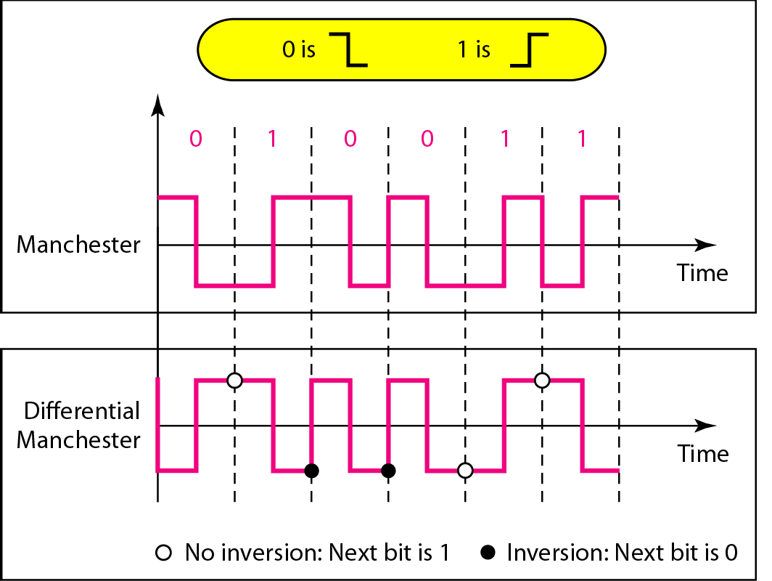
Polar Biphase

